Slide 1
Two sides of the same coin. Health damage from turbine oils in offshore workers and flight crew. How to investigate those who are injured? International consensus on assessment of health damage
Dr Susan Michaelis - PhD, MSc, ATPL, BCA hon
Honorary Senior Research Fellow, University of Stirling, Head of Research, Global Cabin Air Quality Executive, Michaelis Aviation Consulting
Professor Vyvyan Howard – Centre for Molecular
Biosciences, University of Ulster, Coleraine, Northern Ireland, UK.
Captain Tristan Loraine – ATPL, BCAi
Spokesperson, Global Cabin Air Quality Executive
HMS konferanse «Grenseløst arbeidsliv» og
Områdesamling 5. – 7. september 2023

Slide 2
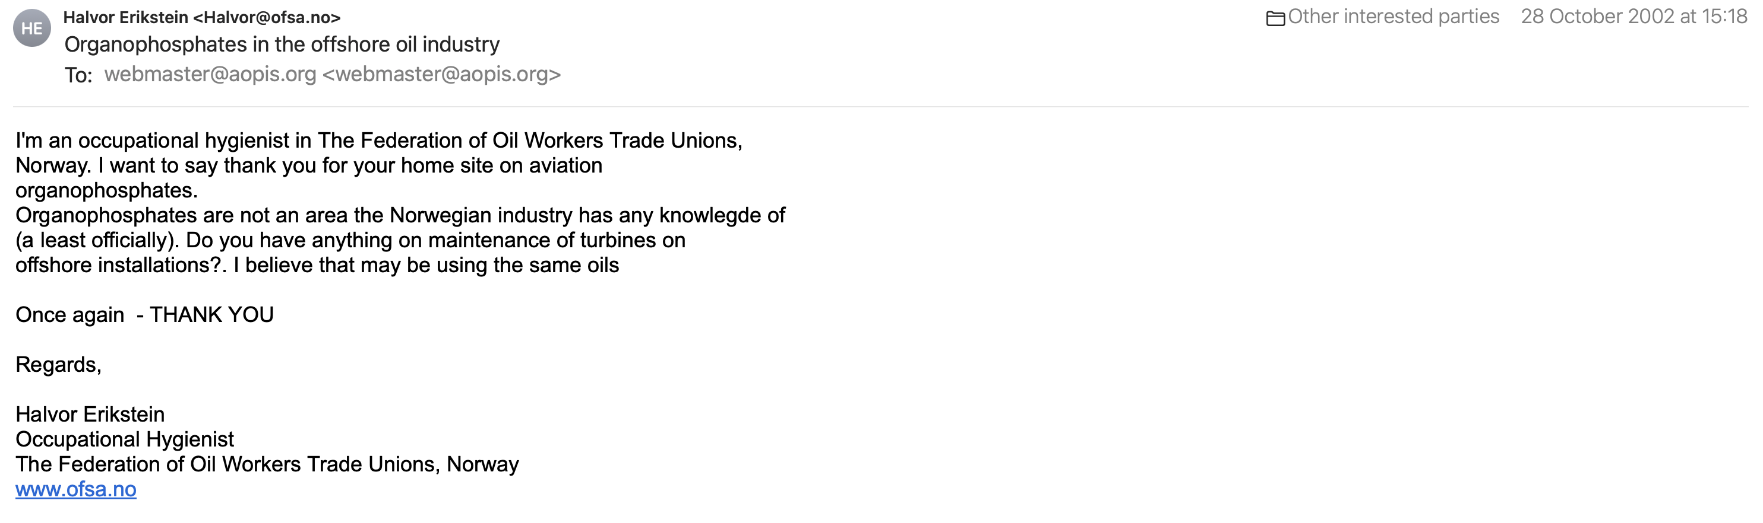


Slide 3
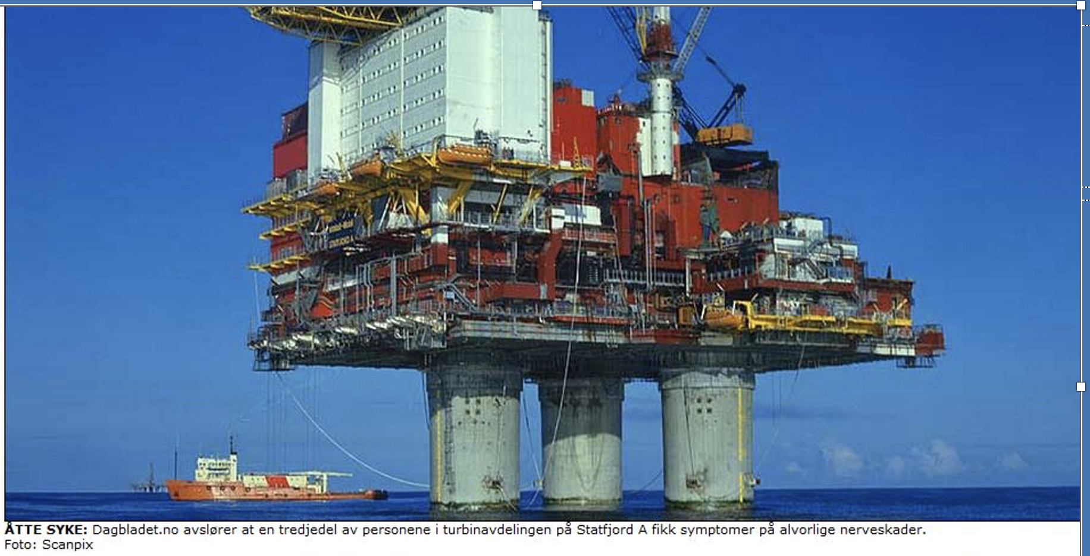
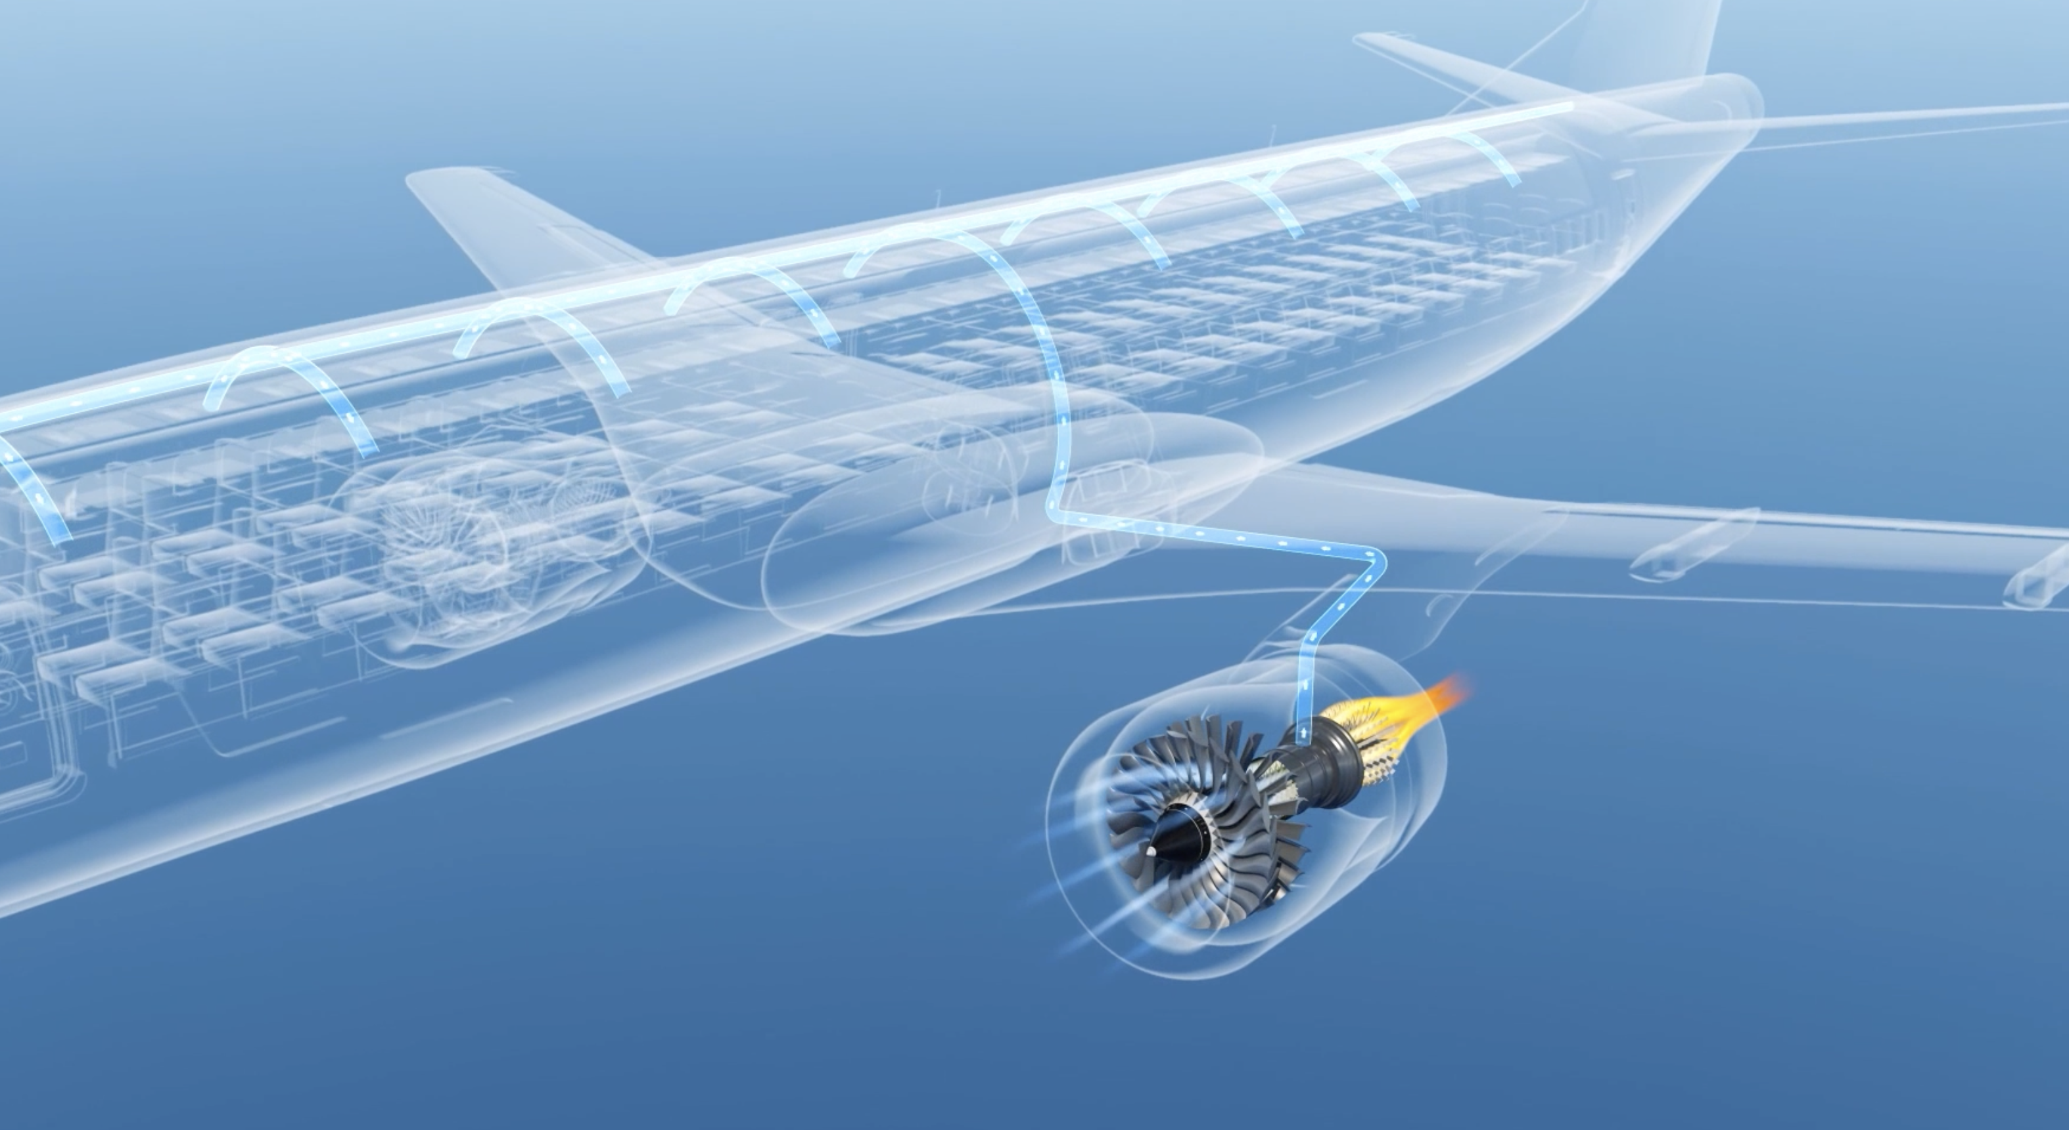
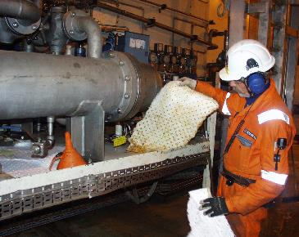
Two sides of the same coin

Slide 4



Seals Minimise leakage

Slide 5
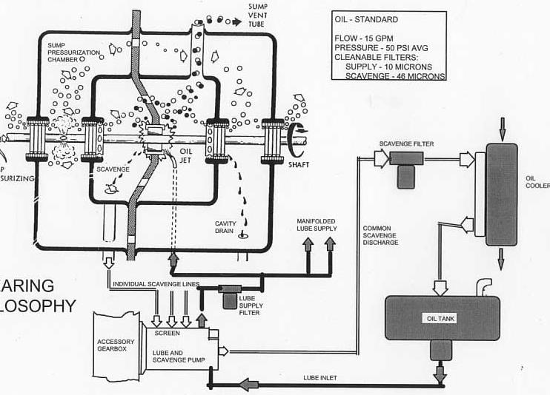
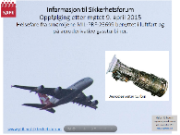
Avluftingspunkter
Sump vent
Smøresystem gassturbin (aeroderivativ turbin)
Eksponering
Eksponering
Vent
oljetank
http://www.ptil.no/getfile.php/1333233/Presentasjoner/Sikkerhetsforum/referater_2015/april/Informasjon%20til%20Sikkerhetsforum%209%20april%202015%20Halvor%20Erikstein.pdf

Slide 6

Why is a narrative review of bleed air exposures and fume events and medical protocol necessary?
Normal
Exposure to aircraft bleed air is occurring
Introduction of synthetic jet engine oils - early 1950s
Exposure happens in 2 ways (documented)
            Background exposures – chronic low level
Normal operation Transient power/ air supply changes….
Abnormal operation: Oil overfill, operational / failure conditions
> Organophosphates, amines, esters, thermally degraded complex mixture
Operational
Failure

Slide 7
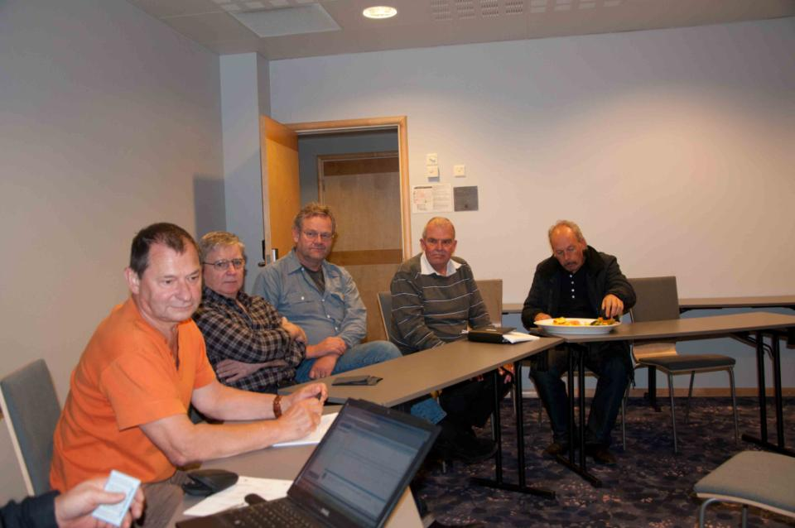
5 turbinteknikere fra Statfjord
Tre hadde levd med multippel sklerose (MS) diagnoser i mer enn 20 år, men mener de er feildiagnostisert.
To ble sendt til undersøkelse med mistanke om MS.
Alle er sikre på at det jobben som har forårsaket helseskadene
Avvist som yrkesbetinget fordi det vi vet i dag ikke var kjent.
MS-saken på Statfjord
1988 ”MS”
1987
1991 ”MS”
1988 ”MS”
MOGENS
TORLEIF
CHARLES
HARRY
ANDRZEJ
Stavanger, oktober 2011

Slide 8
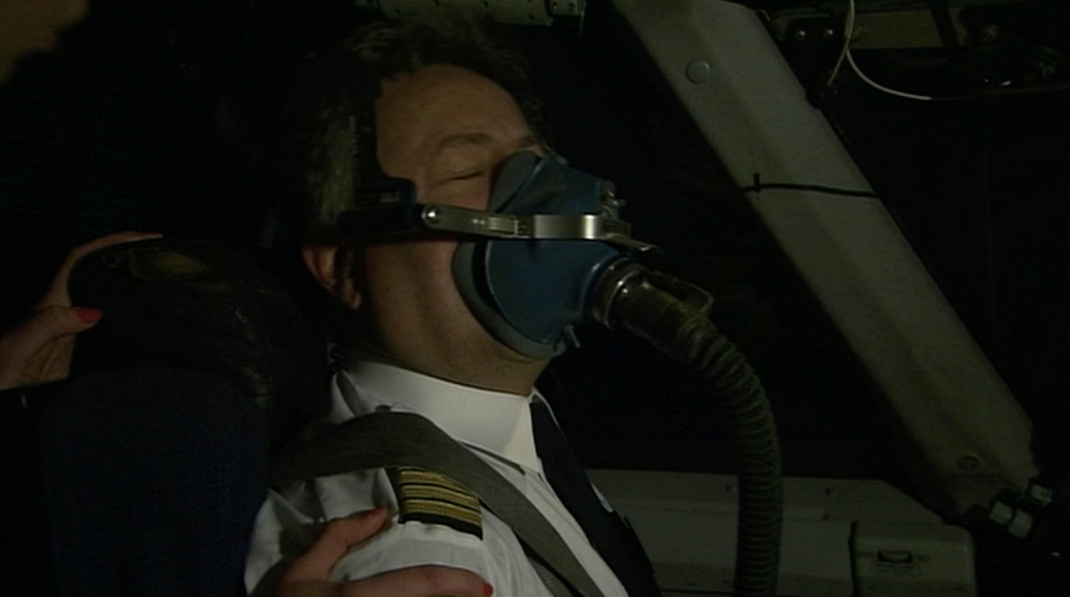
Crew

Slide 9
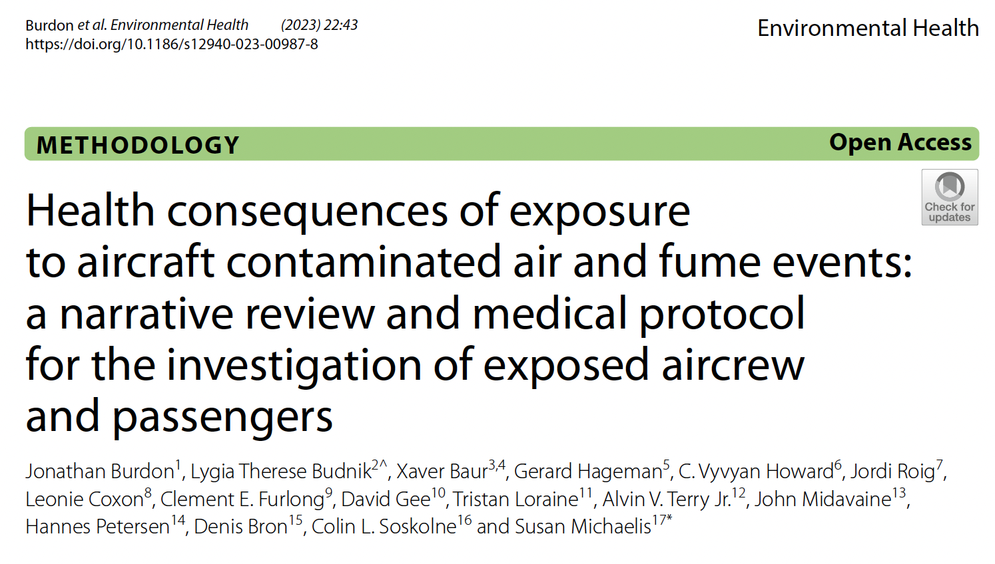

Slide 10
Who are we ?
International Fume Events Task Force
10 countries
    Medical experts: neurological, neurobehavioural, pathology & toxicology, respiratory, aviation medicine, epidemiology, ENT, occupational health……
    Scientists: Pharmacology, medical genetics & genome sciences
    Others: Safety science, airline pilot/technical expert, pollution & policy

Slide 11
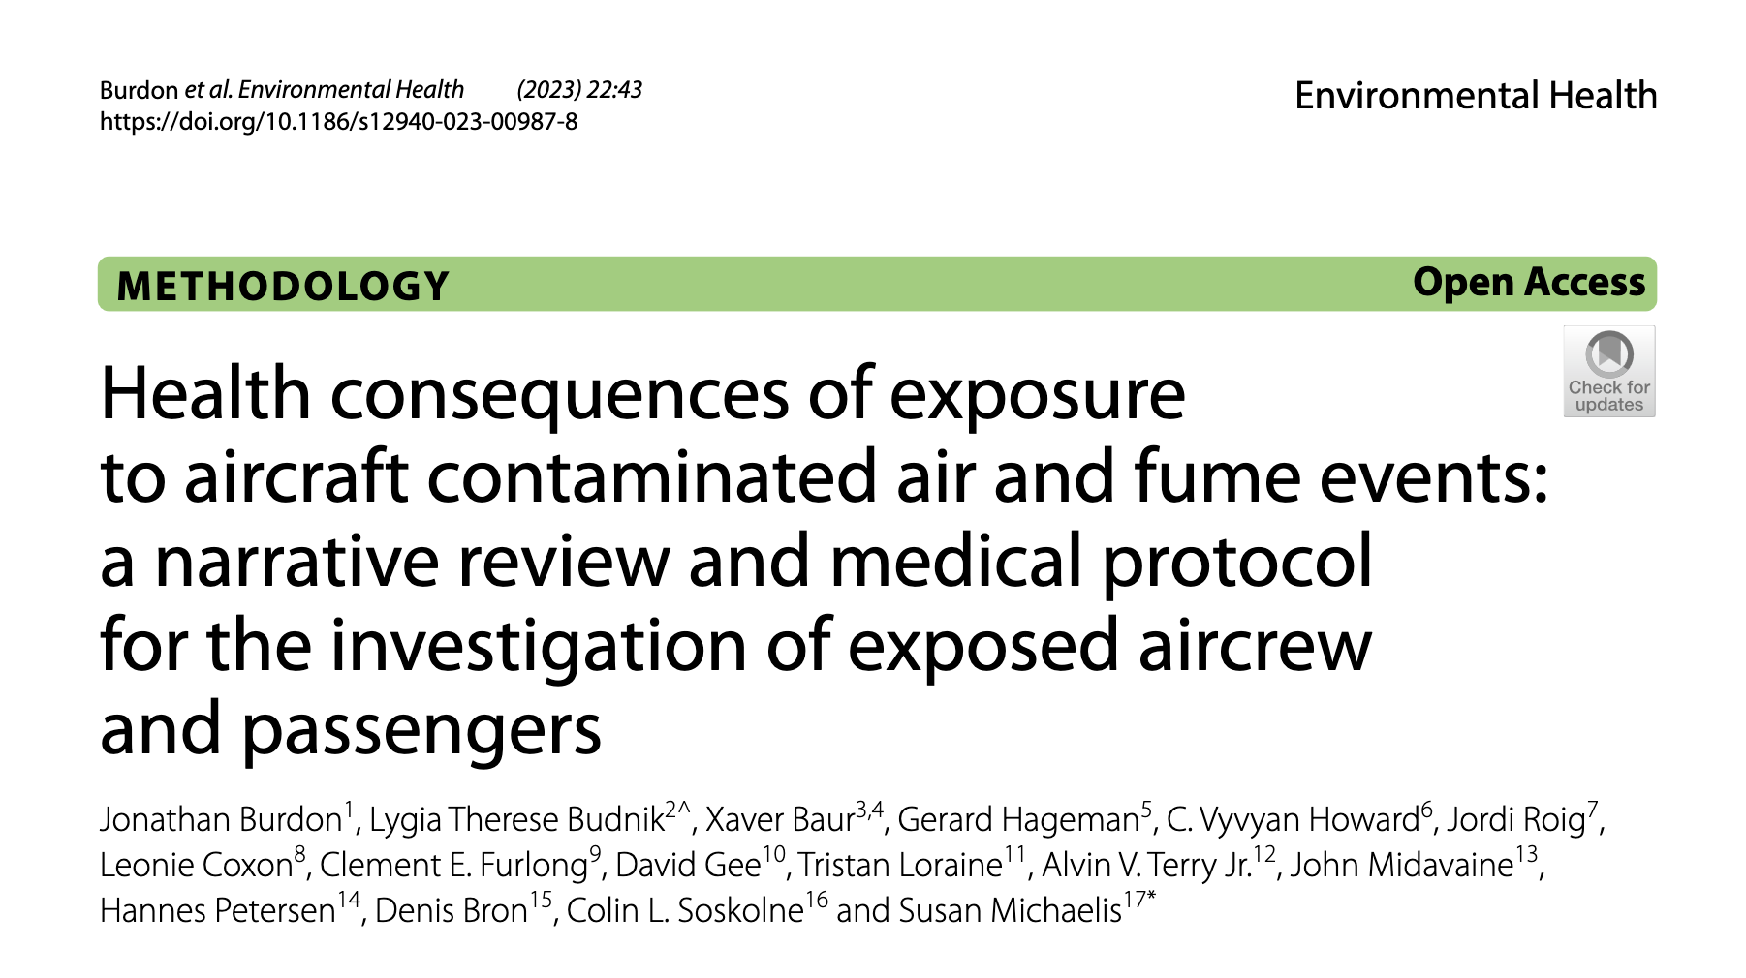
Why is this different? 1/2
    New approach
    1st systematic, comprehensive & timely guidance
    Consensus approach to recognition, investigation and management of people exposed to bleed air contaminants and fume events

Slide 12
Why is this different? 2/2
    Not Reliant On Exposure Limits- Where They Exist – Industry & Regulators X
    Not Looking For TOCP/OPIDN Only X
    Not Reliant On Industry In Vitro/In Vivo Studies Of High
    Dose Exposure Scenarios – FACTS 1 & 2 (EU Funded) X
Epidemiological approach - supported by literature

Slide 13
What is happening to people ?
Diffuse Non Specific Pattern Of Acute And Chronic Effects
Consistent Pattern Internationally
Clear Pattern Of Cause & Effect (Michaelis 2017)
New Occupational Disorder
Neurological, Neurobehavioural, Respiratory, Cardio, GI, General ( Rheumatalogical, Soft Tissue, Fatigue, Chemical Sensitivity…), Irritation, Skin, Sensitization…

Slide 14
DIFFUSE ENCEPHALOPATHY
NON SPECIFIC
PROTEAN
NOT CLEAR
Localising Pattern Recognizable As A Syndrome
DIFFUSE NEUROLOGICAL SYNDROME
(Aerotoxic Syndrome)

Slide 15

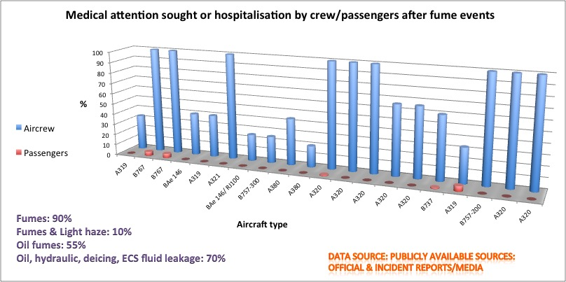
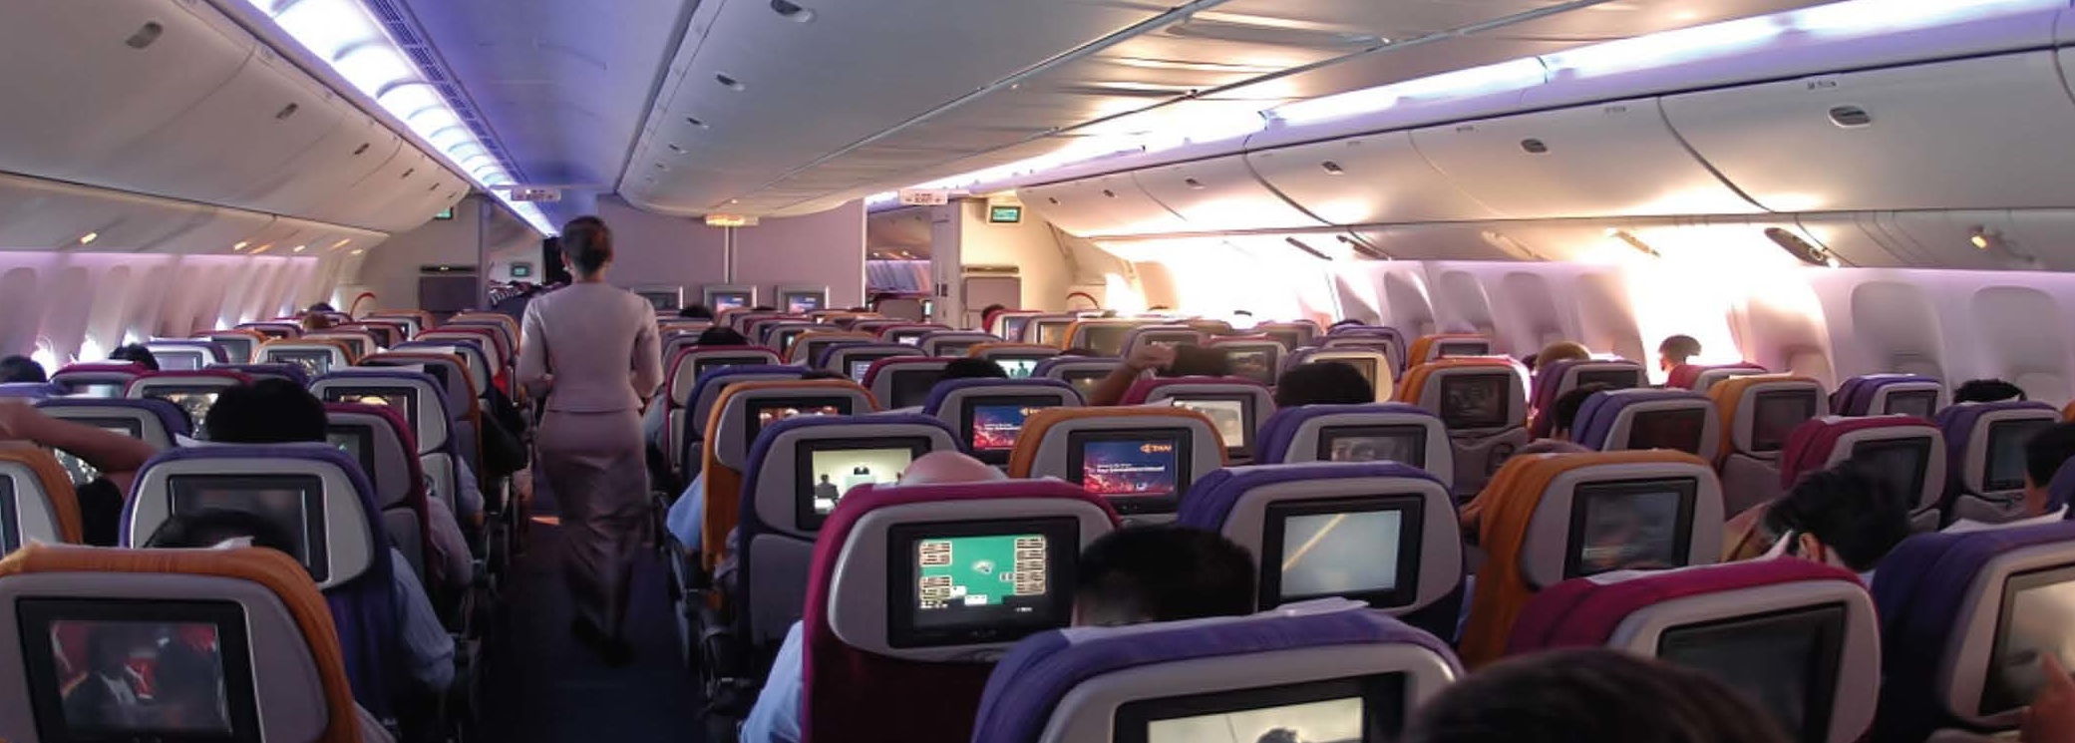

Slide 16
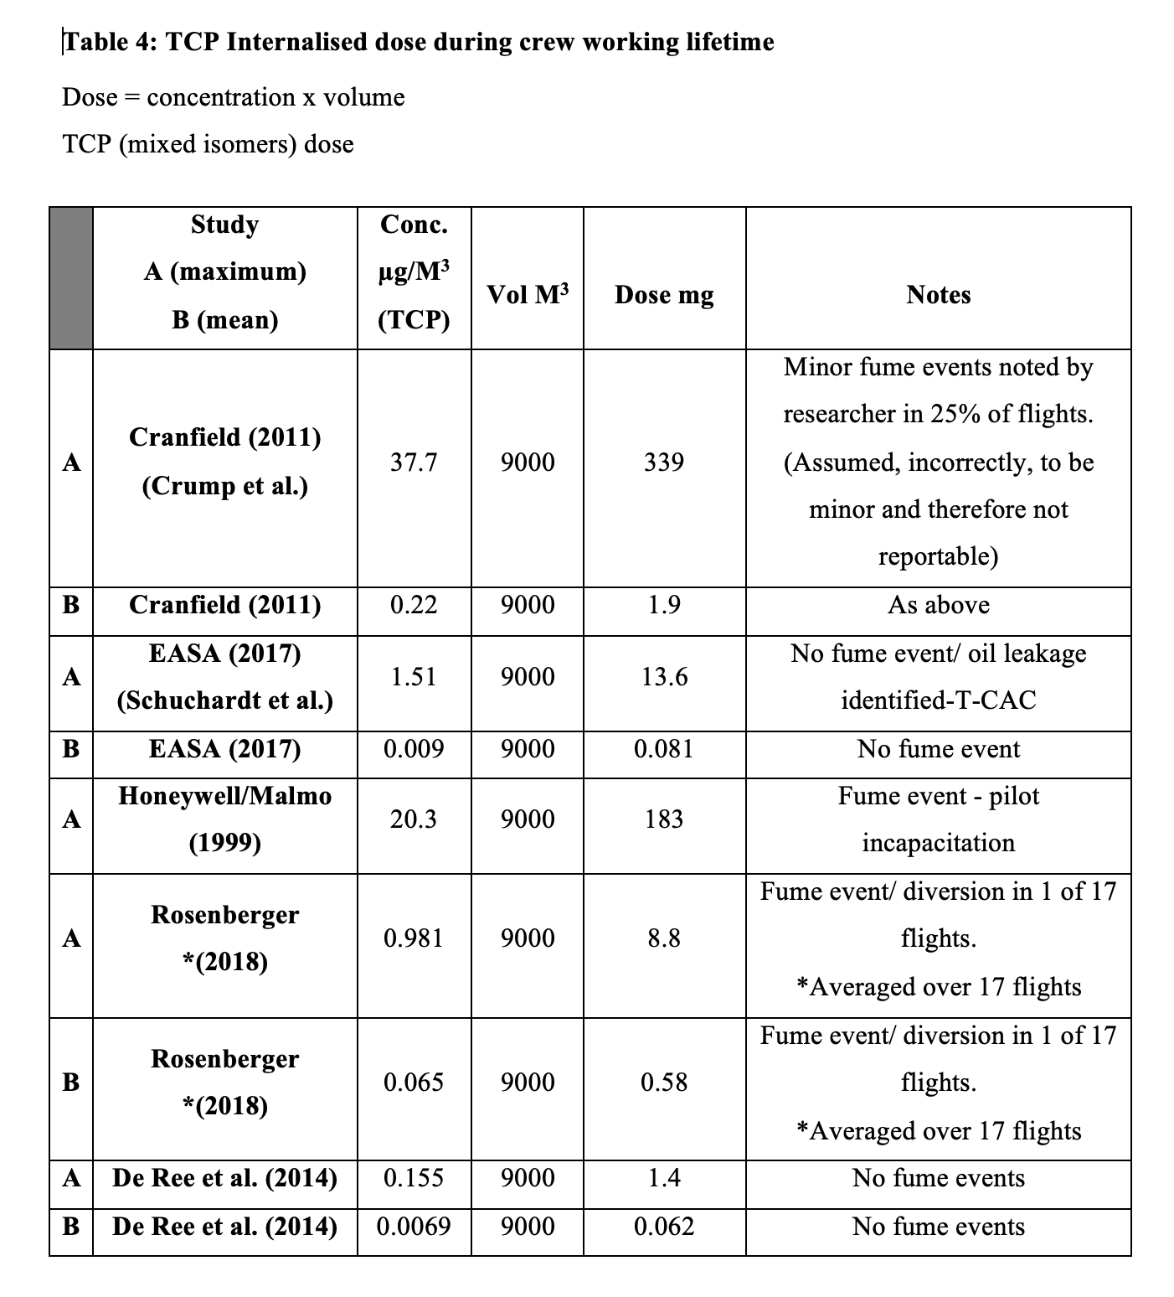
Dose

Slide 17
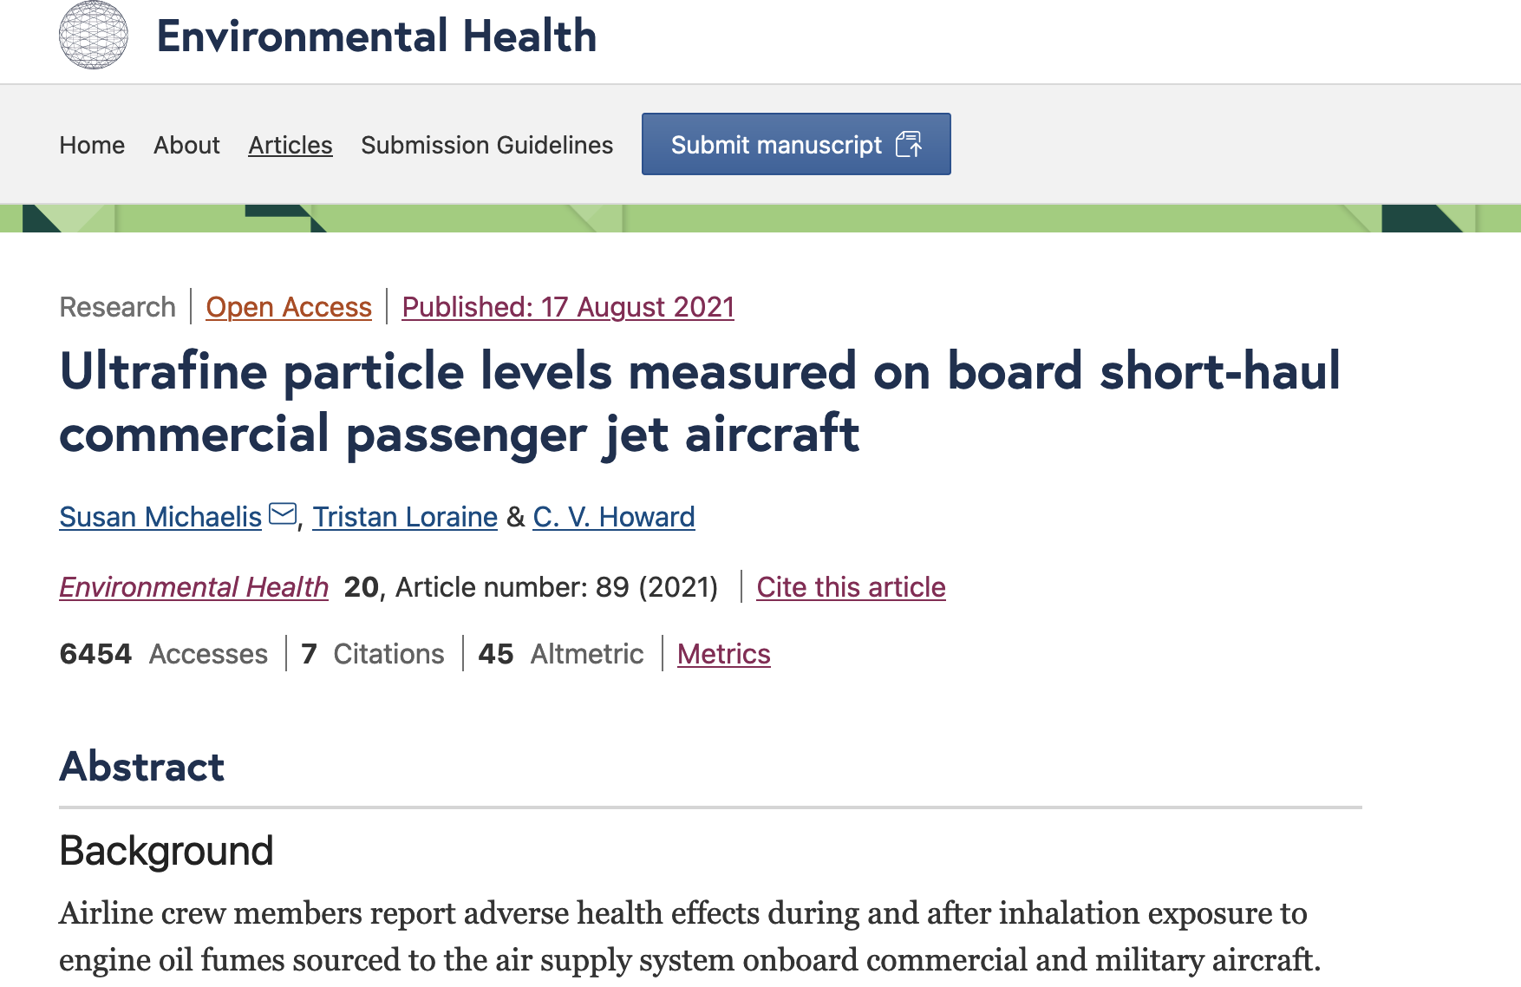
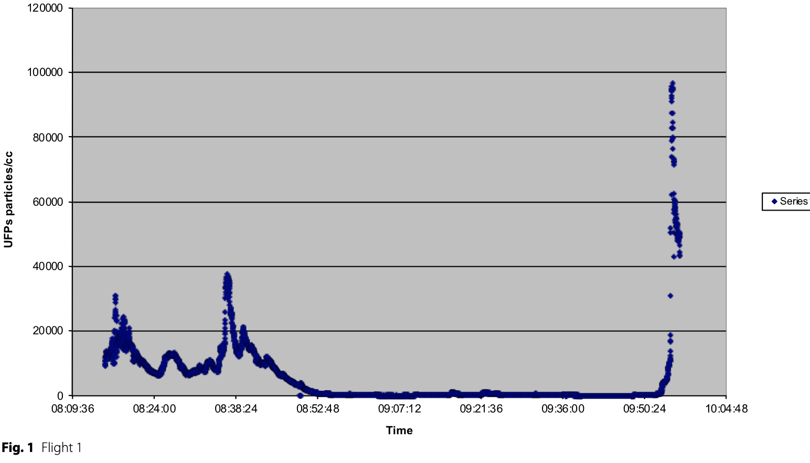
Ultrafine Particles
UFPs linked to wide range of adverse effects
UFPs commonly identified in aircraft air- power turbines
Associated with oil leakage/ oil droplets (Fushmi et al 2019)
Normal flight

Slide 18
Whats coming?
New OILS
Bleed air filtration
contaminated air sensors?
TAP blood test
Bleed free designs
Protective equipment
Medical protocol ✔️
Dutch National Cabin Air Advisory Group (NAC) - Advisory note
https://www.tweedekamer.nl/downloads/document?id=2023D34144

Slide 19
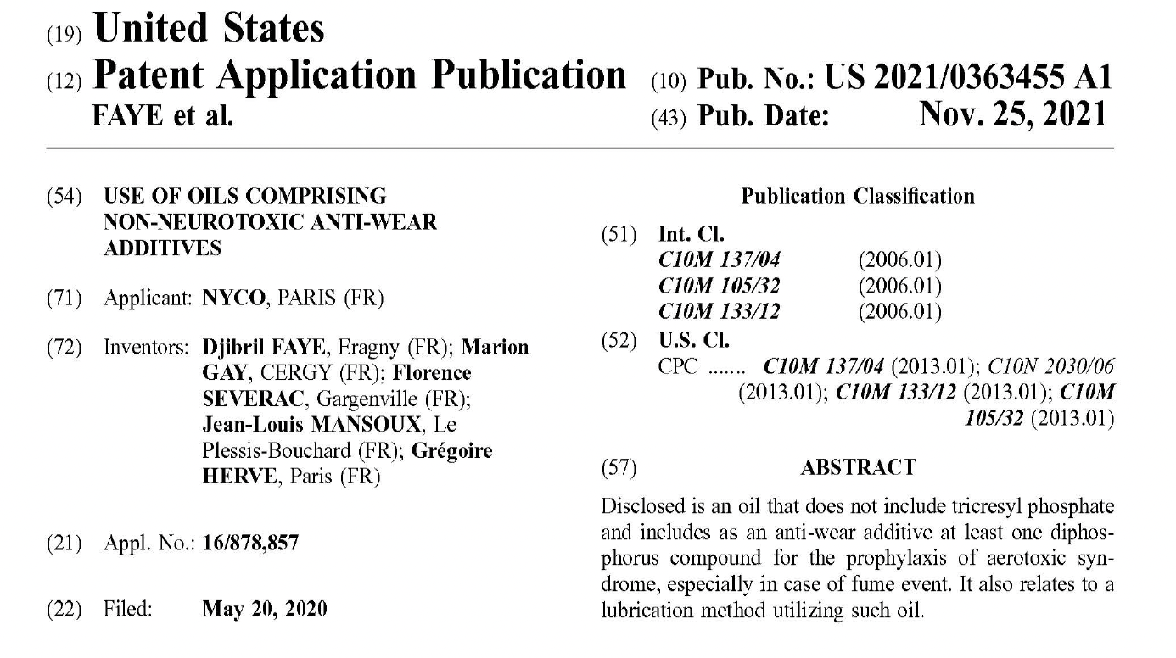
✔️

Slide 20
Further reading
Michaelis S, Loraine T, Howard CV. Ultrafine Particle Levels Measured On-board Short-haul Commercial Passenger Jet Aircraft. Environmental Health. 2021; 20(89): 1-14. Doi: 10.1186/S12940-021-00770-7
Michaelis S, Burdon J, Howard CV. Aerotoxic Syndrome : A New Occupational Disease ? Public Health Panorama (WHO). 2017; 3: 198-211. Https://Apps.Who.Int/Iris/Handle/10665/325308
Burdon J, Budnik LT, Baur X, Hageman G, Howard CV, Roig J, Et Al. Health Consequences Of Exposure To Aircraft Contaminated Air And Fume Events: A Narrative Review And Medical Protocol For The Investigation Of Exposed Aircrew And Passengers. Environmental Health. 2023; 22(1): 43. Doi: 10.1186/S12940-023-00987-8. Https://Doi.Org/10.1186/S12940-023-00987-8
Michaelis S. Aircraft contaminated air: A Brief Outline. International Journal of Sustainable Aviation. 2022; 8(3): 249-59. DOI: 10.1504/IJSA.2022.10047170
Roig J, Domingo C, Burdon J, Michaelis S. Irritant-Induced Asthma Caused by Aerotoxic Syndrome. Lung. 2021; 199: 165-70. DOI: 10.1007/s00408-021-00431-z
SAE. Airborne Chemicals in Aircraft Cabins. AIR 4766/2. Warrendale, PA, USA: SAE Aerospace; 2021. https://www.sae.org/standards/content/air4766/2a. Accessed 1 December 2022
Fushimi A, Saitoh K, Fujitani Y, Takegawa N. Identification of Jet Lubrication Oil as a Major Component of Aircraft Exhaust Nanoparticles. Atmospheric Chemistry and Physics. 2019; 19(9): 6389-99. DOI: 10.5194/acp-19-6389-2019
2023 (NAC advisory note) https://flyaware.nl/en/short-articles/advisory-note-nac/
Many more: e.g. gcaqe.org; susanmichaelis.com

Slide 21
